Slide 1
THIS SLIDE IS FOR INTERNAL DRI PREPARATION ONLY. Delete before forwarding or sharing
Goal of this Presentation:
This presentation is designed to be progressively built by the ESL & Intuitive team leading up to and during the ESL event that your surgeon is attending. During the final Executive Breakout on the day of the event, the ESL will use elements of these slides to lead an alignment conversation with their Executive Sponsor. Here is how the slides break down….
Prepare and Review with your ESL during Intake meeting number 1: Slides 2 – 16
Goals: Executive Discovery / Alignment on MIS > Open / Define Current State of Program / Value Hypothesis on Primary Constraints
Prepare and Review with your ESL during Intake meeting number 2: Slides 17 - 27
Goals: Validate & Articulate Current State through the data /Confirm top constraints / Begin Building an evidence-based strategy focused on top opportunities
Customize this section with ONLY the data slides that highlight top constraints or priorities. 3 to 5 data slides max recommended.
ESL to review and complete with Executive Sponsor during Final Breakout on day of event: Slides 28 – 30
Goals: Achieve dual-KOL status w/ESL & Executive Sponsor to prioritize MIS & drive a strategy to reduce open surgery through a robotic service line / Schedule an ‘All-Stakeholder’ Summit to build the team and align on an evidence-based strategy to achieve programmatic excellence.
**Your finished presentation should be approximately 18 to 22 slides. Begin with Executive Discovery and align on a shared goal. Next insert the data to validate and articulate the current state, primary constraints to programmatic excellence and uncover the most pressing opportunities . End w/vertical integration and Actionable Next Steps to move toward programmatic excellence. ALL LEAD BY A SURGEON LEADER!

Slide 2
Executive Surgeon Leader Program A 5-Step program for Robotic Service Line Leadership
(Insert ESL name)
(Insert ESL title)

Slide 3
Agenda for today:
Align on Shared Goals
Current State Analysis for Robotics
Identify & Discuss Primary Constraints & Opportunities
Align on top priorities

Slide 4
The WHY affects the WHAT Aligning on shared goals
What is the Mission & Goals of the Hospital?
How does the hospital measure value?
What are the hospital priorities – what matters and why?
Notes:
The purpose of this slide is ‘executive discovery’. The ESL should lead a conversation with his/her Exec Sponsor to understand what is important to Administration and how is value measured. Dig deep and find common areas to align. Ultimately sharing a common mission.

Slide 5




Hospital/Community impact of our Robotic Service Line Aligning on Shared Goals
Open Approach
MIS Approach
“Nothing
is done better through
an open incision”
Notes:
Action: This slide can be used to further articulate the QTI of a Service Line Mentality, specific to it’s alignment w/the Quad Aim. This slide can be eliminated if you feel it’s redundant w/the prior slide.
Quote attributed to: Melissa Phillips, MD FACS / Asst. Professor of Surgery @ Univ of Tennessee and ESL Clinical Program Faculty

Slide 6

Notes:
This slide is a ‘sample’. You can customize this slide from the “Executive Surgeon Leader Current State” Tableau tool.

Slide 7
Impact of a world class Robotic/MIS service line Aligning on a Shared Goals
Improved Outcomes
Improved Clinical Experience
Reduce Cost of Care
Improved provider Experience
Notes:
MIS aligns with Hospital and patient priorities. Aligned to the Quadruple Aim and focused on improving outcomes at a reduced cost of care and improved experience for patient and provider.
If aligned on MIS > Open ……Question to the Exec Sponsor: Are you at a point where we can create executive focus on robotics?
Yes/No….
ESL to Exec Sponsor: Who needs to be involved in the process
ESL to Exec Sponsor: What do we need to show them?
ESL to Exec Sponsor: Great! Therefore our goal today isn’t about whether we should create focus on MIS & Robotics, but instead, now it’s about what type of focus do we provide & what key stakeholders are needed to drive the right strategy.

Slide 8
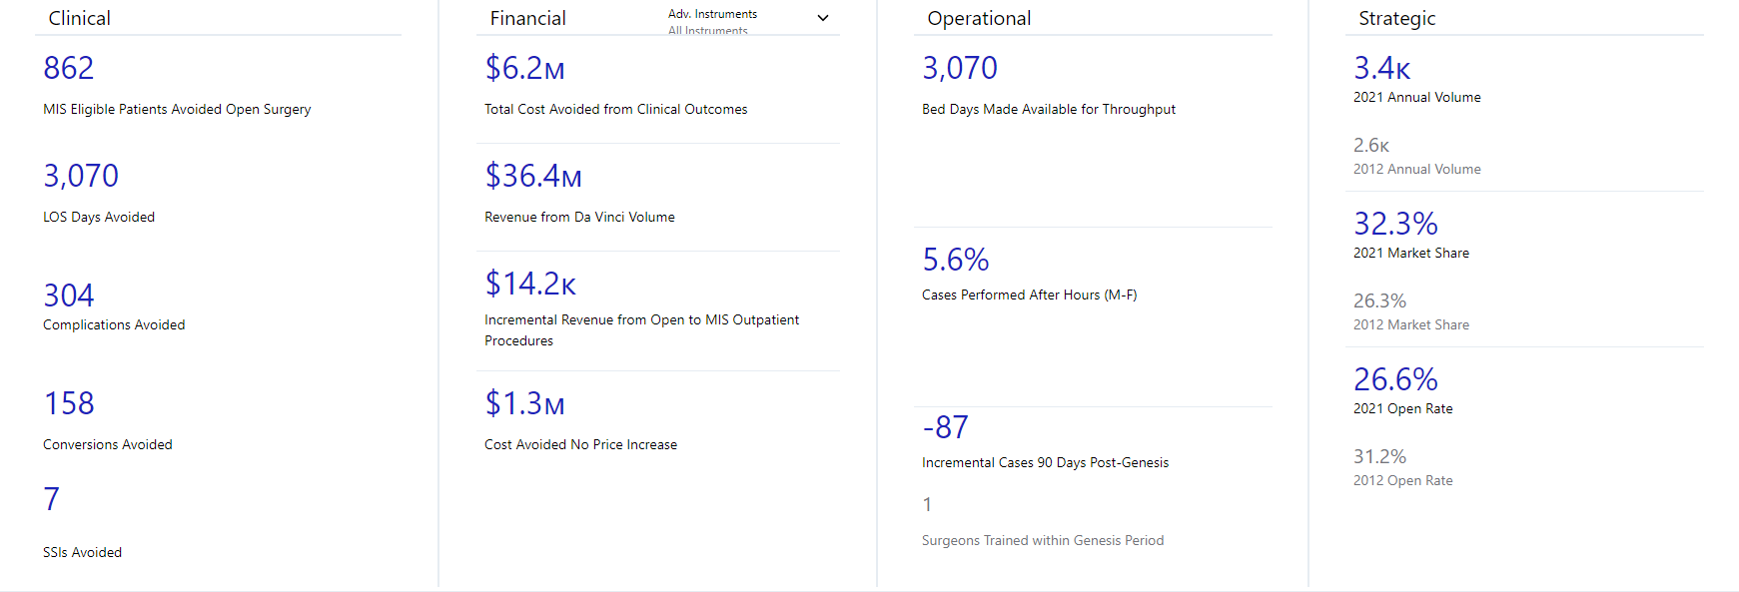
Current Robotic Value our Institution is experiencing through daVinci Clinical | Financial | Operational | Strategic
Notes:
This slide is a ‘sample’. You should pull this account / IDN specific VALUE SUMMARY slide from the ABAM tool.

Slide 9
“Insert Hospital Name” Robotics Service Line Current State Analysis
Notes:
Customize with Hospital/IDN name

Slide 10
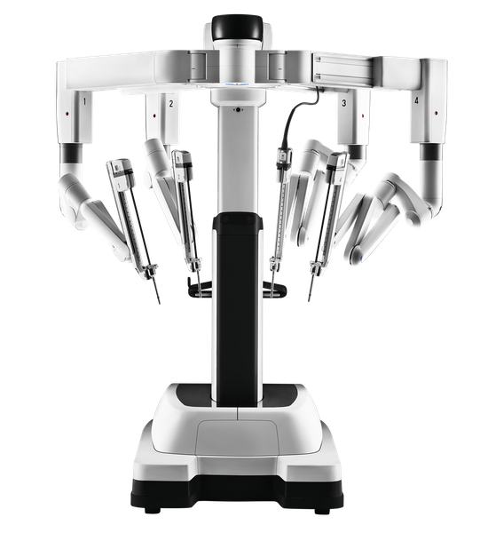
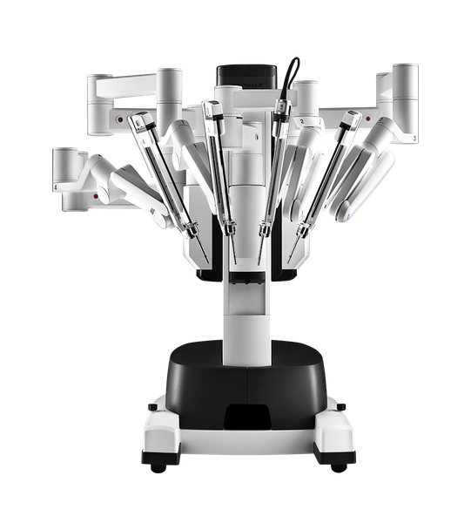
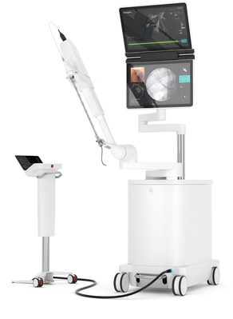
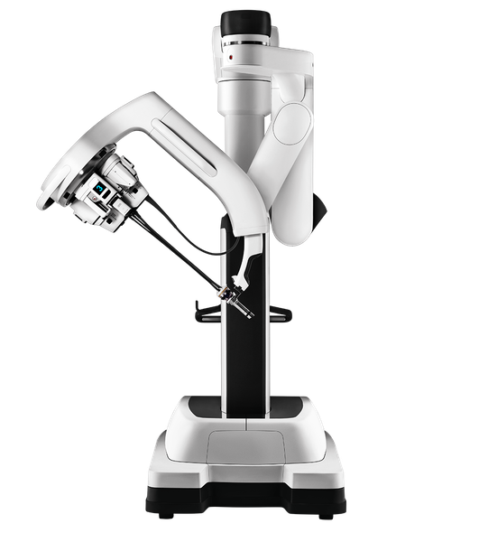
Current Technology Footprint
49 da Vinci Surgeons
Hospitals w/Robots
ABC Hospital
XYZ Hospital
ASC 1
Notes:
Customize to match the current Technology footprint for your ESL

Slide 11
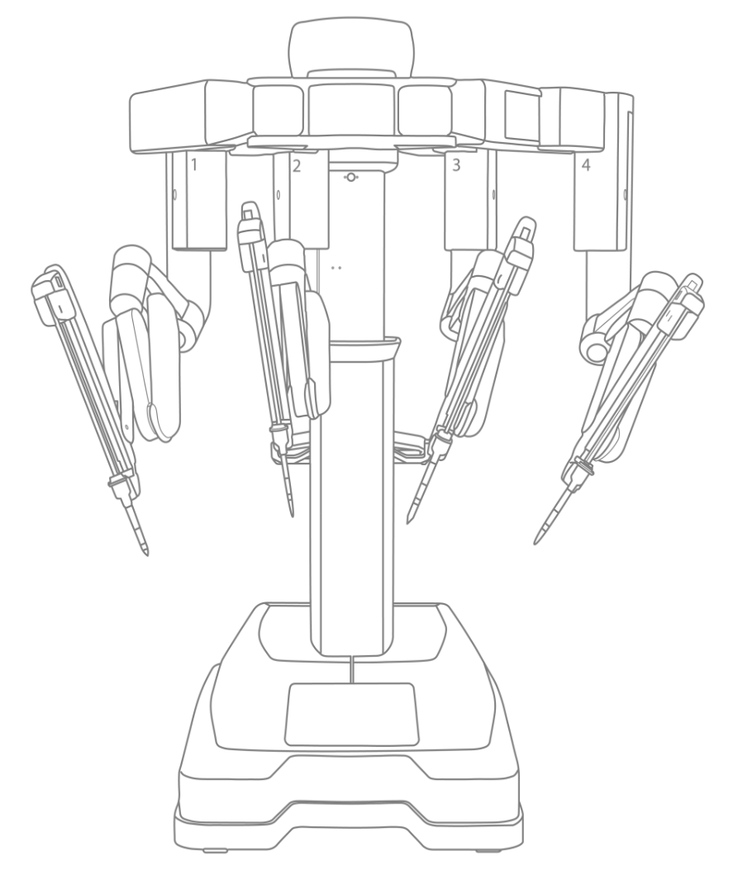
Robotic Surgery Service Lines
Cardiac Surgery
Thoracic Surgery
Urology
Gynecologic - Benign
Gynecologic - Oncology
Urogynecology
Colorectal
General Surgery
Surgical Oncology-Whipples
Head & Neck
Notes:
Update this slide: Change the color of each specialty. Blue = a robotic sub-specialty exists & Red = Non-participating robotic specialty.

Slide 12
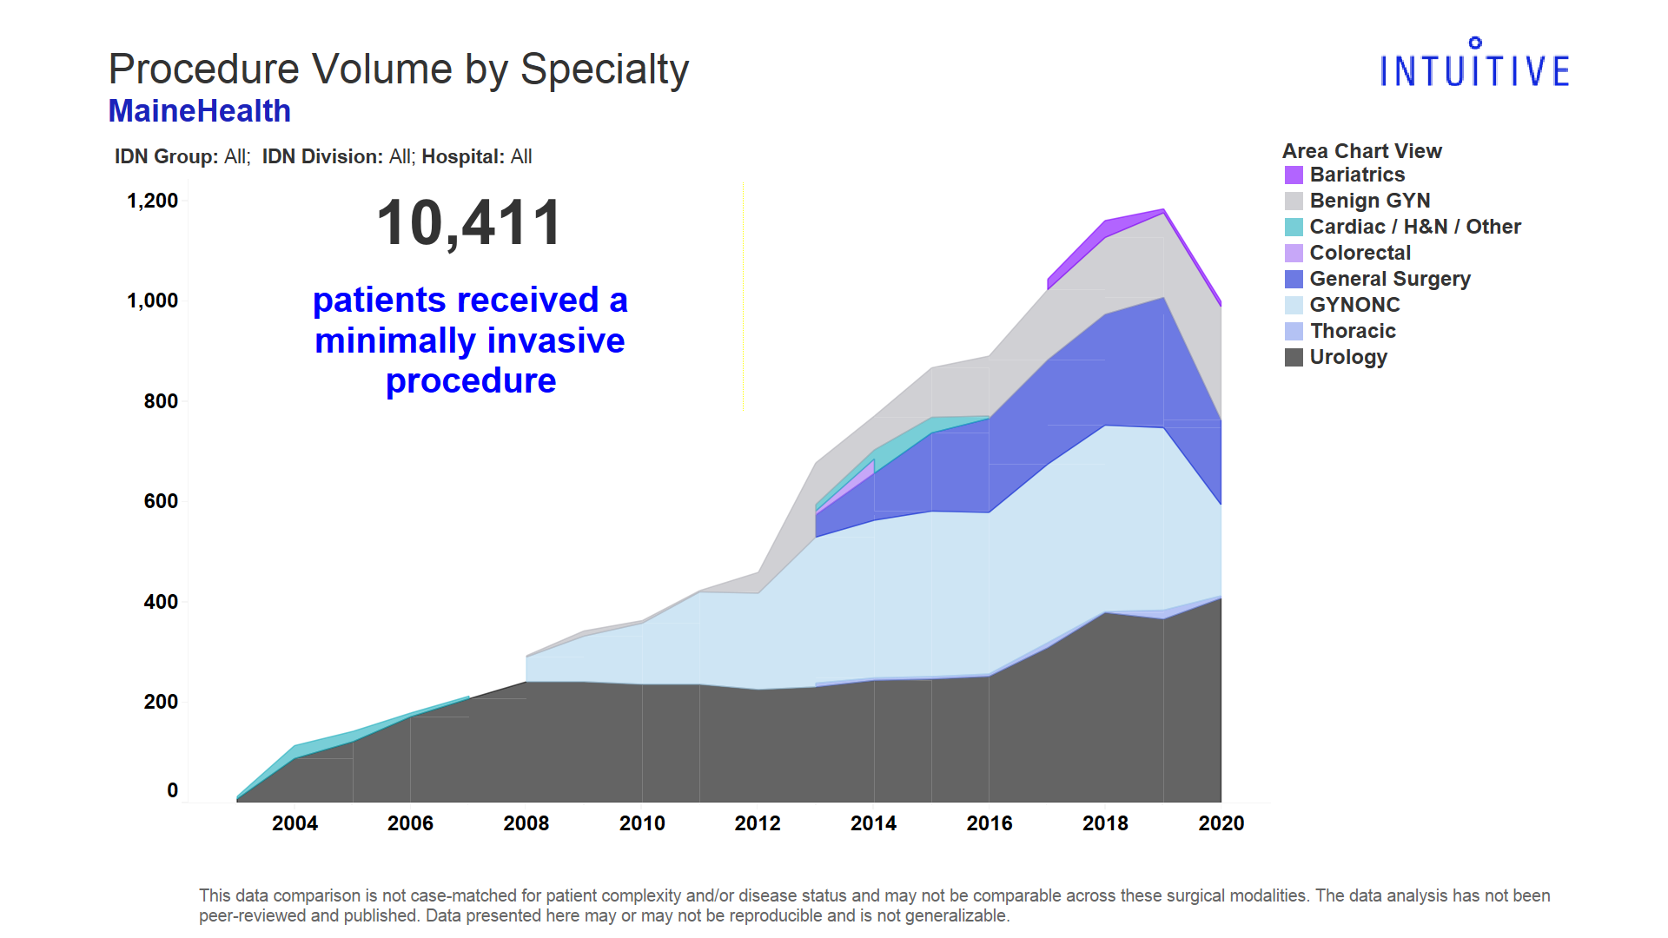
Notes:
This slide is a ‘sample’. You can customize this slide from the “Executive Surgeon Leader Current State” Tableau tool.

Slide 13
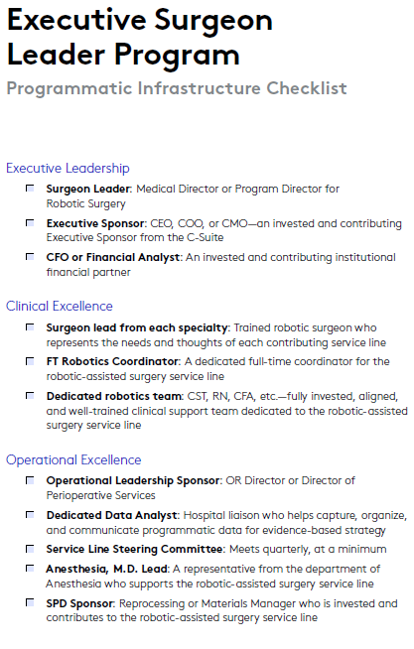
Team Infrastructure Building a world class team
Key Takeaways:
Need an executive sponsor for Robotics
Need surgeon lead from each specialty to participate in Steering Committee
Need a dedicated date analyst
Etc.
Notes:
The key takeaways are examples. You should customize the key takeaways to the needs of your ESL’s true team needs that you’ve identified with them and consider adding names to each if you have individuals that you’ve discussed with them.

Slide 14

Beginning with the end in mind…..Where are we now? Providing a pathway to robotic service line excellence
Metric
Phase 1
Phase 2
Phase 3
World Class
C-Suite Engagement
Program Structure
Technology Innovation
Service Line
Access
Productivity
Data Insights
None
Partial
Active
Champion
No Formal Structure
Quarterly Steering Committee
Special Task Force
Collaborating with Intuitive
3rd Generation Technology
4th Generation Standardization
4th Generation with Advanced Technology Utilization
4th Generation Technology with Digital Integration
25% Addressable Procedures
25-50% Addressable Procedures
50-75% Addressable Procedures
75-100% Addressable Procedures
Urology and / or Gynecology
General Surgery Utilization
Multiple Specialties
with Expanded Access
Multiple Specialties with Unfettered Access
25th Percentile in Peer Group
50th Percentile in Peer Group
75th Percentile in Peer Group
90th Percentile in Peer Group
No Formal Data Review
Data Review Limited to Customer Portal and / or Procedure Volume
Formal Review and Access to Robotic Data & Benchmarks
Collaborating w Intuitive to Share Data for Strategic Decision Making
* “World Class” is a phase of the Maturity Model pathway only and should not be interpreted as anything other than the top phase of such model. The status of a hospital’s program is determined solely by such hospital, and Intuitive does not make any representations regarding any hospital’s program.
Notes:
Purpose of Slide
This slide is to introduce and explain the Maturity Model.
Talking Points
We have built a model to help assess and understand the current state of your robotics program. There are 7 metrics combined with associated phases of adoption which will help the hospital build a world class program.
These 7 metrics are:
C-Suite Engagement: This metric measures the engagement and advocacy of executive leadership in the robotics program vision and execution.
Program Structure identifies where this hospital or health system is for having structure around its program. It considers operational governance like steering committee and task force design.
Technology Innovation measures the level of advanced technology available at the hospital
Service Live measures what portion of addressable procedures are being performed with RAS
Access is a measure of how accessible robotic technology is for RAS trained surgeons to book or perform their cases as desired
Productivity measures the hospitals current state for how many procedures are performed per day, per system
And Data Insights provides a view of how well the hospital collects, analyzes, and uses their data for strategic decision making.
Format Background colors of blocks and change font colors to assign current state for the hospital/network
14

Slide 15



An evidence-based strategy to align with Administration
+
+
Access
Belief
Coordination
Block Underutilized
Expand to After Hours
Increase Elective Surgery
Mixed Fleet Challenges
Outpatient Strategy
Surgeons can’t schedule cases
System(s) Underutilized
No Unfettered Access
Cost of ownership too high
Costs too much
No clinical value vs. lap or open
Poor payer mix
Restricted case mix
Systems are under-utilized
Takes too long
Financial value to the hospital
No Executive Sponsor
No Operational Leader
No Steering Committee
Staffing not optimized
No IDN/Network Strategy
Par levels not optimized
Too much variation in OR Time
Too much variation in OR Cost
Notes:
Highlight top constraints impacting the program and reinforce through the data on the following slides

Slide 16

(Insert Name of Institution/IDN) Robotic Service Line Executive Sponsor(s)
Key Executive Decision Makers supporting our robotic service line:
1.
2.
3.
Who needs to attend the ESL Program with me:
xxx
Next steps to secure their commitment to attend:
Step 1
Step 2, etc.
Notes:
This slide should be used to conduct discovery and/or validate with your ESL who the appropriate Executive Sponsor is of the Robotic Service Line that the ESL will align with to attend the upcoming ESL Program. You should align on how and when the ESL (accompanied by you if appropriate) will seek to gain the commitment of the Executive Sponsor to attend.

Slide 17
Insert any data on the following slides that support the current state analysis or define a priority opportunity/constraint that needs to be addressed
Notes:
Any data slides that you choose to use to support the current state analysis can either come from the Tableau Current State Module and/or any other data sources (i.e. ABAM, QTI, MACA) that you have access to. The goal is to meet them where they are and leverage the most applicable data sources to support the current state narrative.

Slide 18
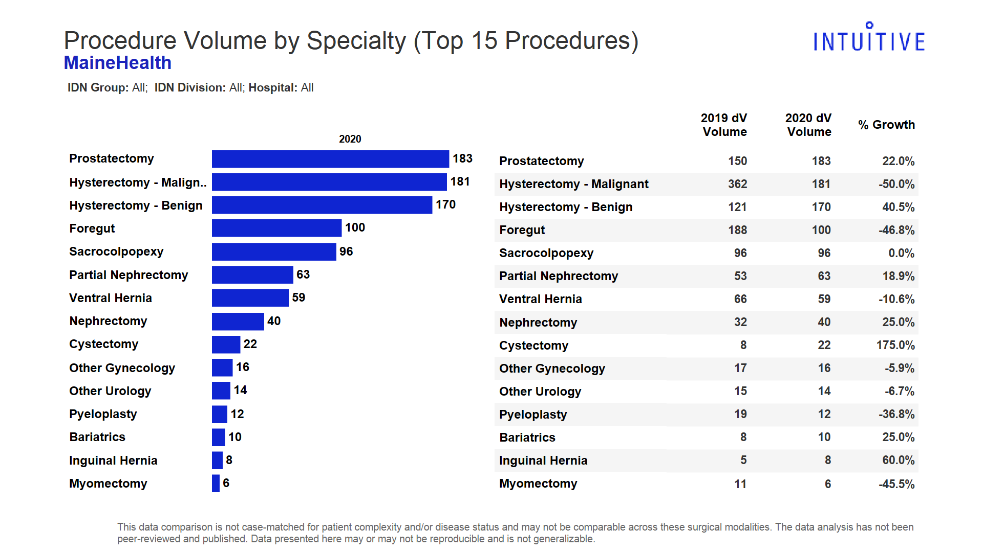
Notes:
This slide is an OPTIONAL ‘sample’ slide. You can customize this slide from the “Executive Surgeon Leader Current State” Tableau tool.

Slide 19
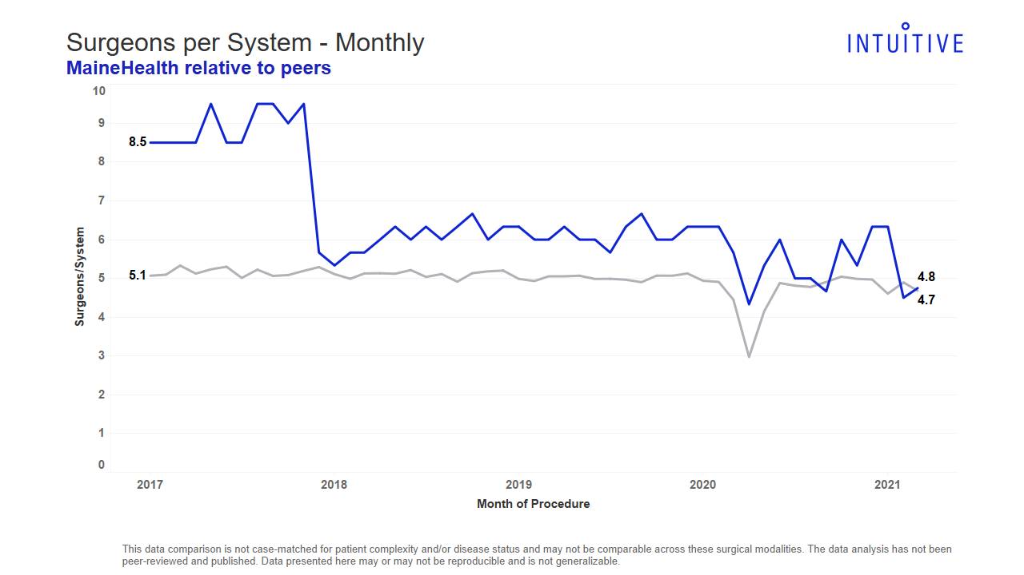
Notes:
This slide is an OPTIONAL ‘sample’ slide. You can customize this slide from the “Executive Surgeon Leader Current State” Tableau tool.

Slide 20
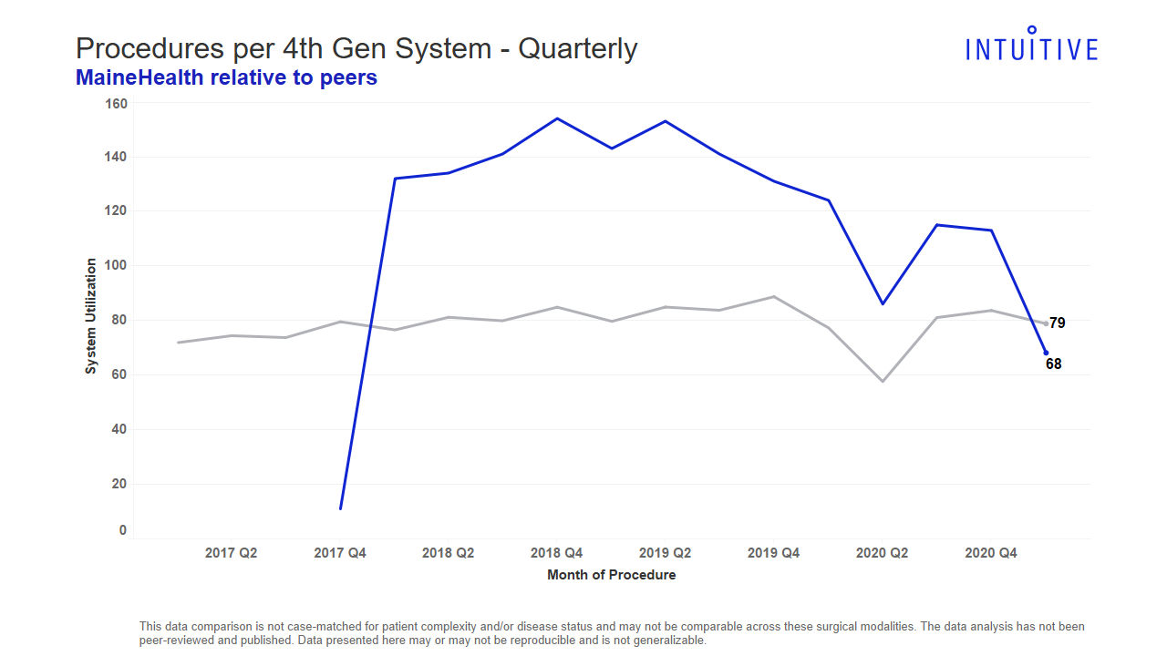
Notes:
This slide is an OPTIONAL ‘sample’ slide. You can customize this slide from the “Executive Surgeon Leader Current State” Tableau tool.

Slide 21
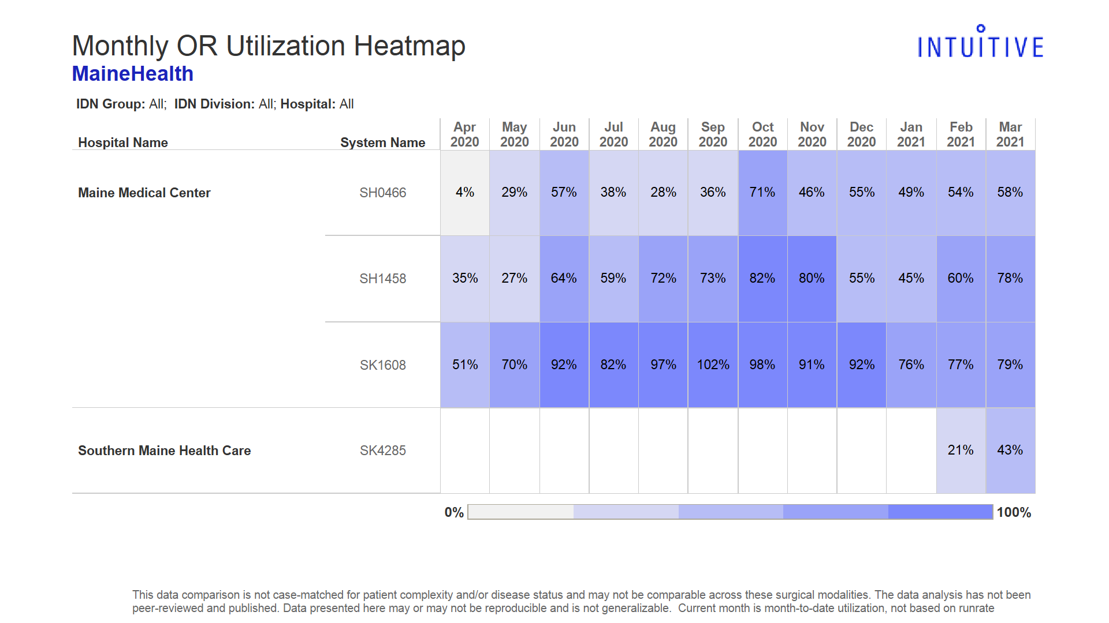
Notes:
This slide is an OPTIONAL ‘sample’ slide. You can customize this slide from the “Executive Surgeon Leader Current State” Tableau tool.

Slide 22
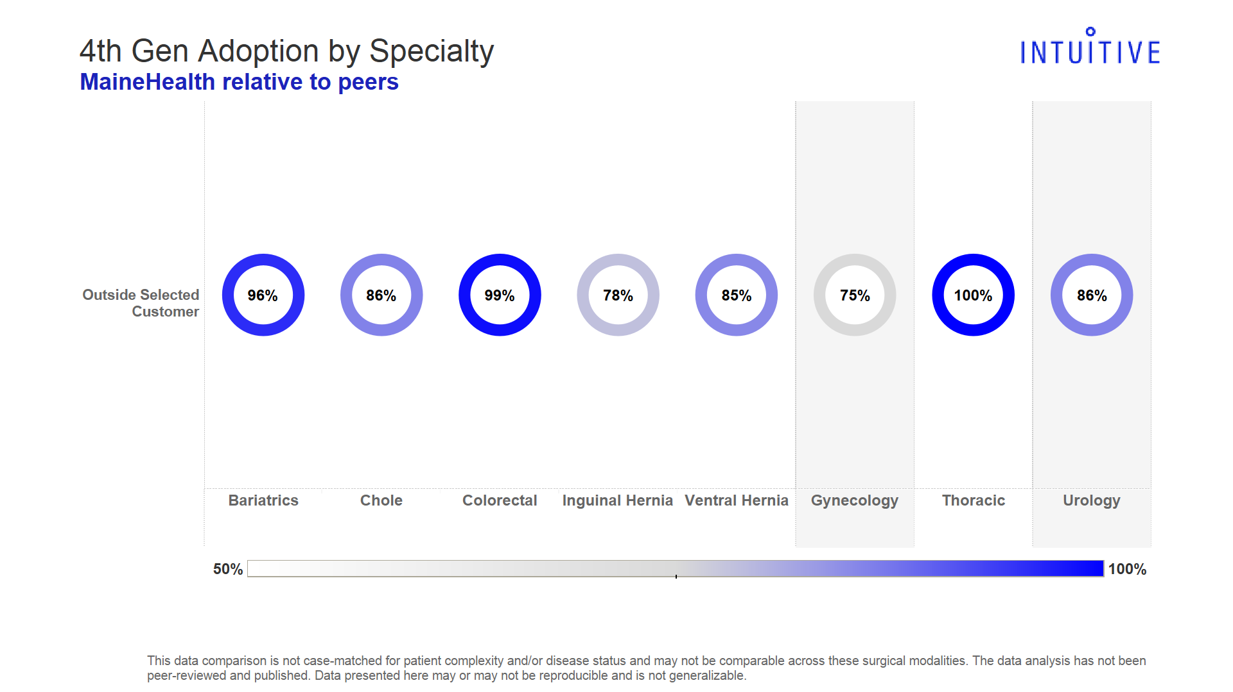
Notes:
This slide is an OPTIONAL ‘sample’ slide. You can customize this slide from the “Executive Surgeon Leader Current State” Tableau tool.

Slide 23
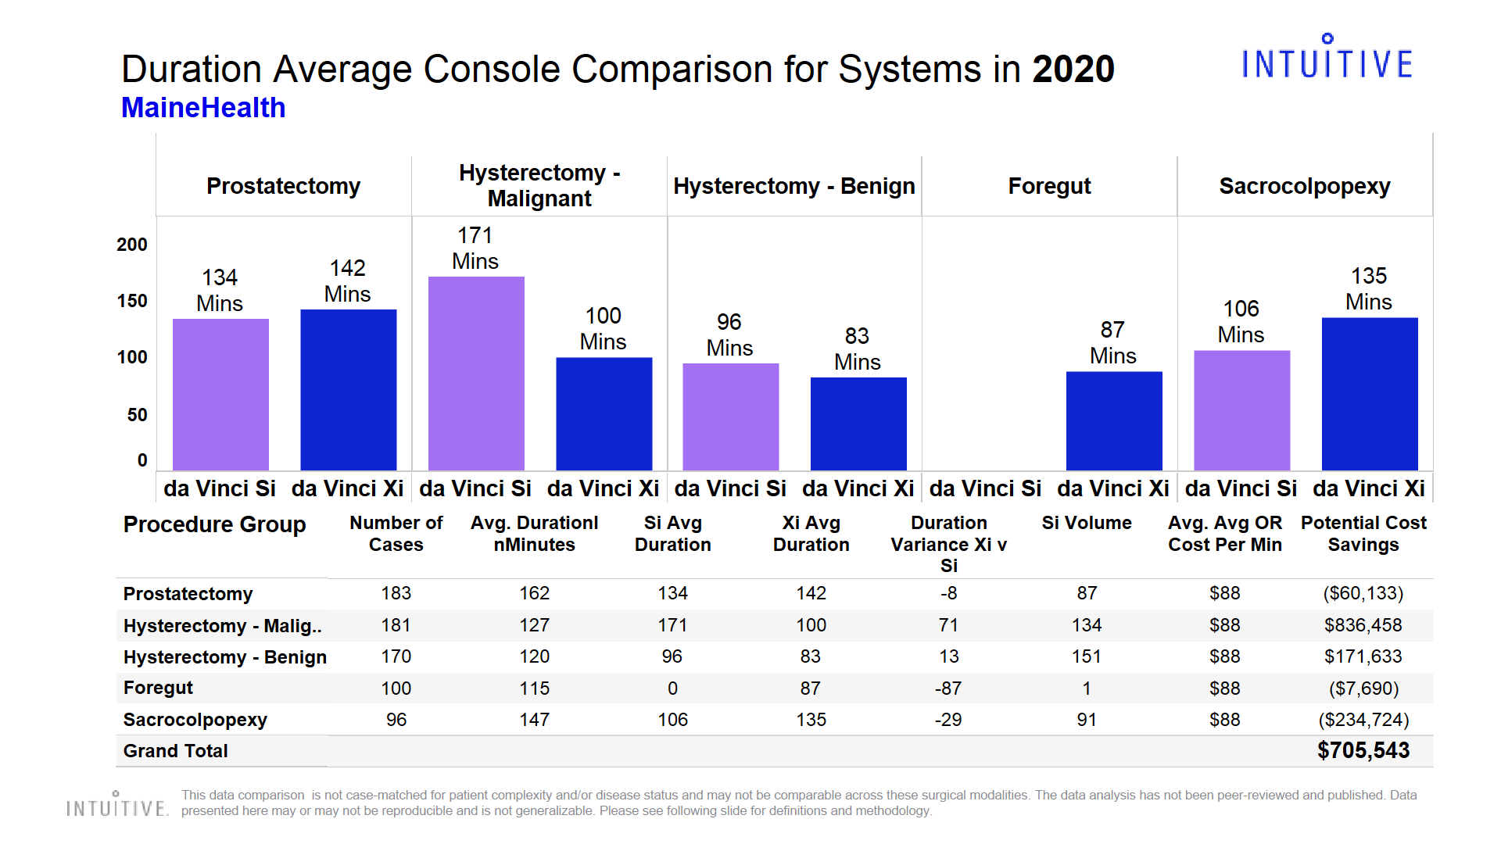
Notes:
This slide is an OPTIONAL ‘sample’ slide. You can customize this slide from the “Executive Surgeon Leader Current State” Tableau tool.

Slide 24
What’s Next?
Building a World Class Robotics Service Line
Notes:
The next few slides are designed for the ESL and you to align on the top two or three priorities for the Robotic Service Line and his / her practice and should be reviewed with the Executive Sponsor during the final breakout.

Slide 25
Identify & develop a plan to make an immediate impact on the service line Define The Pattern
Current State
Gap
Future State
Key Elements
Gap: Identify the gap (pain) that exists today.
Timeframe, location and trend: Describe when and where the problem is first observed and what kind of trend it is following
Impact: Quantify the gap (cost, time, quality, environmental, personal, etc.
Importance: To the organization, team members, patients, etc. to better understand the urgency.

Slide 26
Key Opportunities for the Robotic Service Line…
Current State
Future State
Impact of Future State
Where are the Gaps?
Steps to Address the Priorities…
Quantify (Cost, Time, Quality, etc.)
Priorities to address:
1. **Customized by surgeon leader
Steps to address:
1. **Customized by surgeon leader
Steps to quantify:
1. **Customized by surgeon leader
Notes:
Optional Slide to identify priorities

Slide 27
Opportunities for my practice…
Current State
Future State
Impact of Future State
Where are the Gaps?
Steps to Address the Priorities…
Quantify (Cost, Time, Quality, etc.)
Priorities to address:
1. **Customized by surgeon leader
Steps to address:
1. **Customized by surgeon leader
Steps to quantify:
1. **Customized by surgeon leader
Notes:
Optional Slide to identify priorities

Slide 28
Priority Matrix
Higher
Urgency
Lower
Must Do | Fill Gaps in the Infrastructure Update antiquated Block Establish Steering Committee CHA Agreement and Data Exercise w/MACA | Genesis Engagement for Efficiency improvements | Establish Robotic Residency Training Program Establish an outpatient robotic program
Should Do | Attend 360 | Create Center of Excellence for MIS Hernia Surgery
Could Do | Direct to Patient Marketing | Recruit Robotic Thoracic & Colorectal trained surgeons
Higher
Impact
Lower
Notes:
Optional Slide to “pull it all together” and prioritize the High Priority/High Impact Objectives.

Slide 29
Next Steps:
Notes:
Define next steps for the Service Line to address top priorities/constraints to achieving programmatic excellence. Keep it focused, clear & concise. Limit to the top 3 objectives.

Slide 30
A Summit to Create Vertical Alignment Leadership Goal: One team, one goal. Influence others & delegate to future leaders
+
+
Executive Leadership
Clinical Excellence
Operational Excellence
Robotic Summit (Key Stakeholders who MUST participate):
Executive:
Clinical:
Date for Summit Meeting: _____/_____ /_______
Operational:
Intuitive:
Notes:
Action: List the Key Stakeholders that need to consistently participate and contribute to the Steering Committee in order to create & maintain Vertical Alignment.
Action: Commit to & Schedule a date for a Service Line Committee meeting that the ESL & the Executive Sponsor will co-present the Business plan & vision for the Service Line.

