Slide 1
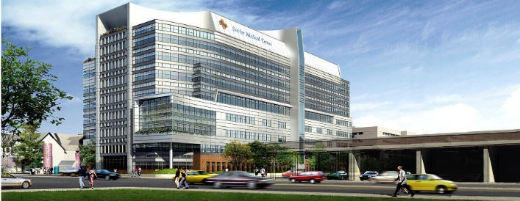

Executive Surgeon Leader
Building Your Team:
Where to Start & Next Steps to a World-Class Robotic Program
Michael Beneke, MD FACS
Medical Director of Robotic Surgery
Sutter Medical Center, Sacramento

Slide 2
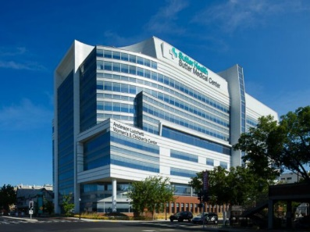
ABOUT ME
Completed residency
Joined SMG/SMCS
2002
2017
Medical Director of Robotic Surgery
2015
da Vinci Xi Training

Slide 3
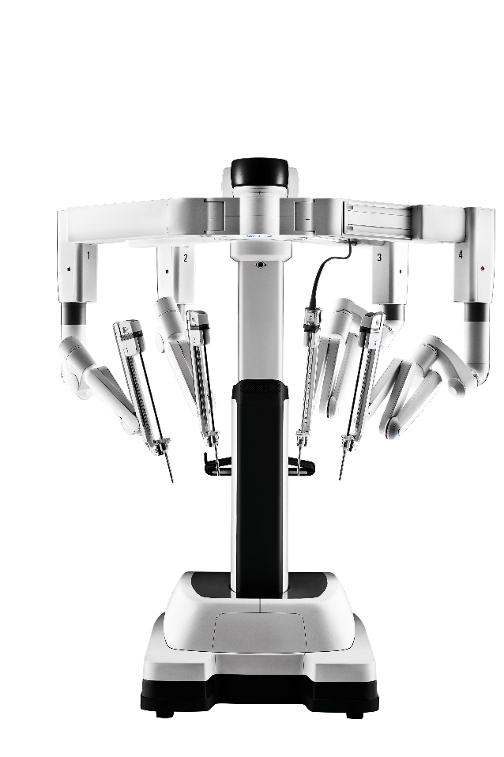
SUTTER MEDICAL CENTER, SACRAMENTO
Main OR
HOPD

Slide 4
The Golden Circle
WHY – Your Purpose
Your Motivation. What do you believe?
HOW – Your Process
Specific actions taken to realize your WHY.
Why
WHAT – Your Result
What do you do? The result of WHY. Proof.
How
What
Think, Act & Communicate from the INSIDE OUT!

Slide 5

The “WHY”
DEFINE YOUR PURPOSE:

Slide 6


True North

Slide 7
2015 SMCS mission statement
Evolve from a group of individual surgeons “doing robotics” into an organized multispecialty robotics program
Provide an exceptional PATIENT-CENTRIC EXPERIENCE
Leverage a team approach to IMPROVE PROVIDER EXPERIENCE thereby becoming the preferred program for a robotic surgical practice
Utilize evidence-based medicine, program efficiency, data, and conversation to DECREASE COSTS and IMPROVE OUTCOMES
Achieve the QUADRUPLE AIM
Improved outcomes
Improved provider experience
Improved patient experience
Decreased Cost

Slide 8
The “How”
DEFINE YOUR PROCESS:

Slide 9
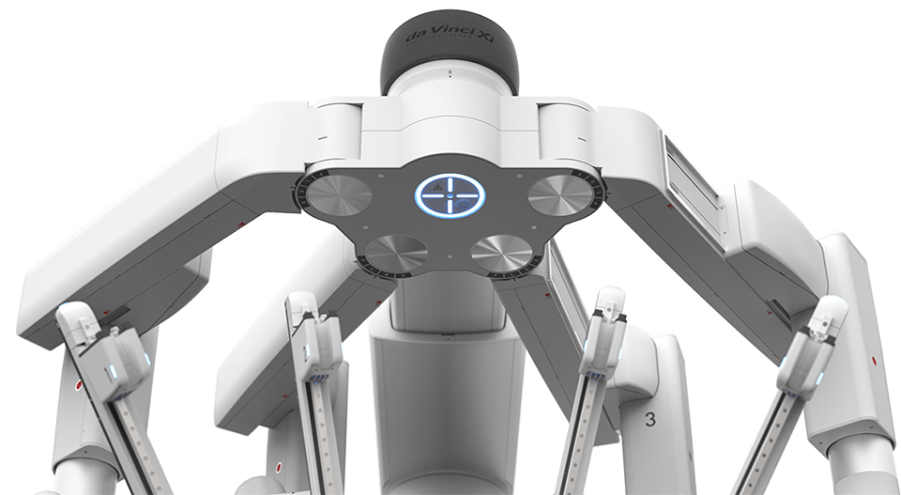
Pillars of Program Excellence
Clinical Excellence
Operational Excellence
Executive Leadership
Notes:
9

Slide 10
EXECUTIVE SURGEON LEADER ATTRIBUTES
High integrity
Data driven (Evidence-based medicine)
Technically competent
Moral compass
Trustworthy
Sees the forest, not just the trees
Brings people and causes together
Good communication skills
Respects and is respected
Cost conscious
Team mentality
Understands healthcare trends
Opportunistic (the Power of Moments)
Provides focused recognition
Has the time
Has the passion
Fosters a culture of nurturing
Actions speak louder than words
Is inquisitive
Learns from mistakes
Takes ownership
Elevates everyone’s game
Capable of crucial conversations
“The CEO”, “The Conductor”

Slide 11


See the forest, not just the trees
Instrument and accessory costs
Capital costs
Overtime and overhead costs
System Value
Total cost of care impact
Length of stay
ICU admissions
Blood Transfusions
Conversions
Complications
Readmissions
Surgical site infections
Pain management
Disability / RTW

Slide 12
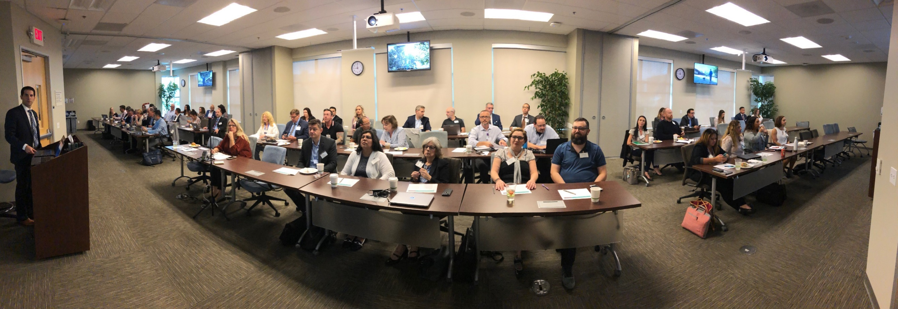
BRING PEOPLE AND CAUSES TOGETHER
2019 Sutter Health Robotic Surgery Symposium

Slide 13


Alignment

Slide 14

Robotic Program Stakeholders & Priorities
Surgeon
Executive
OR Staff/Admin
Patient
Access
Efficiency
Experience (patient & self)
Safe Care
Data (outcomes & cost)
Reliable Team & Equipment
Ancillary Services/ Program
Budgets
Total Cost of Care
Regulatory Requirements
Safe Care (zero harm)
Growth/Volume
Staff Engagement/EOW
Patient Experience
Healthcare Equity
Community Health
Efficiency
Waste Reduction
Cost Containment
Safe Working Environment
Staffing
Staff Experience of Work
Safe Care
High Quality Care
Affordable Care
Positive Experience
Healthcare Equity

Slide 15
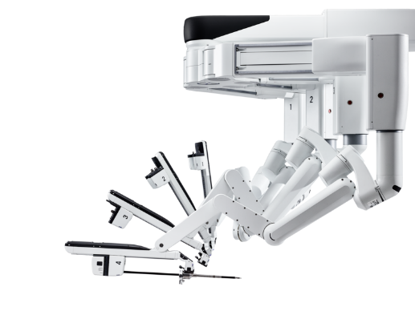
Pillars of Program Excellence
Clinical Excellence
Operational Excellence
Executive Leadership
Standardize surgeon credentialing
Facilitate team education and educators
Data: transparent, accessible, outcomes
Notes:
15

Slide 16

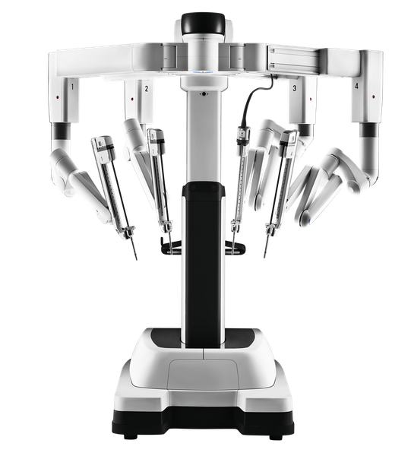






Clinical Excellence
Executive Surgeon Leader(s)
High standards for re-/credentialing
Supply cost and case length comparisons
Peer review PSR’s and generic screens
Track all-cause readmission and ED visit rates
Ancillary programs (e.g., ERAS, APS, EGS)
ALOS and Average Direct Cost

Slide 17
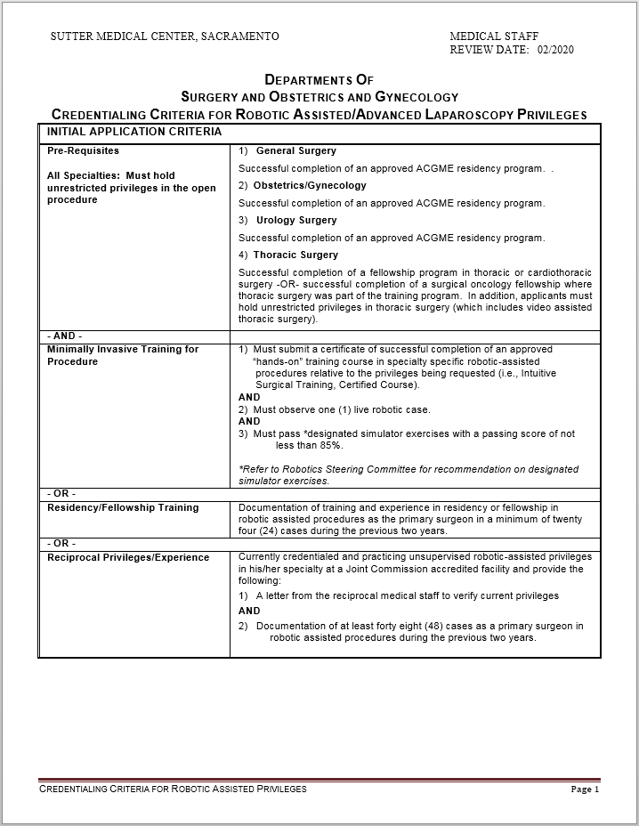
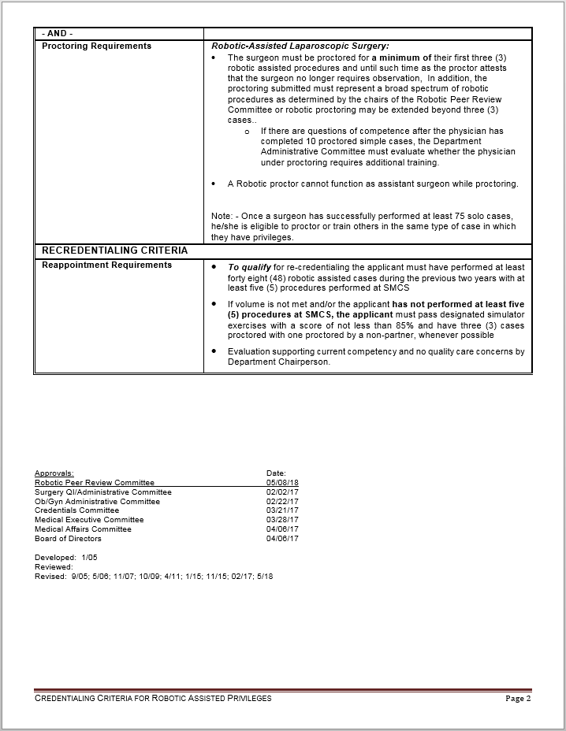
Credentialing/Recredentialing
48

Slide 18


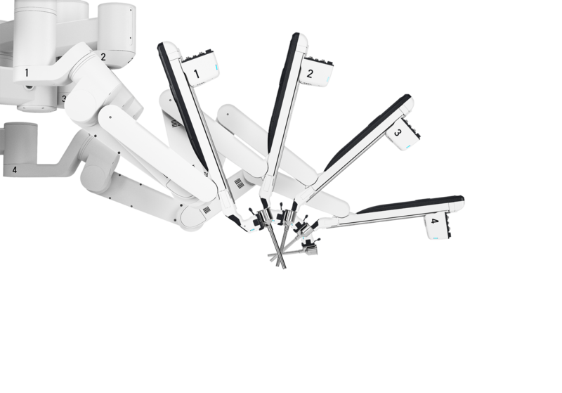




Robotic Peer Review Committee
Subcommittee of Surgery and Ob-Gyn Departments
Physicians: Uro-Gyn, Gyn-Onc, Urology, General Surgery
Medical Staff Office support
Business Manager of Surgical Services
Ad hoc members of nursing and administration
Meets Bimonthly; CEC 1157 protection

Slide 19






Robotic Peer Review Committee
Patient Safety Report (PSR)
30-day readmission event
Blood transfusion
Intra-operative consult request
Conversion to open
Unplanned return to the OR
Peer Review Triggers

Slide 20
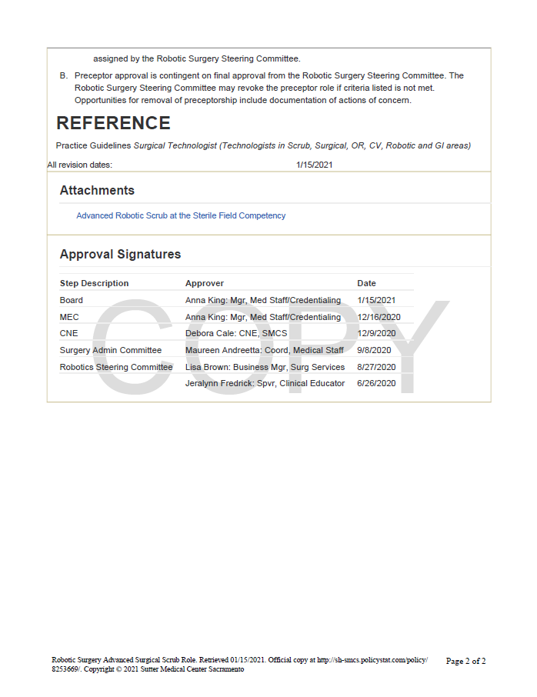
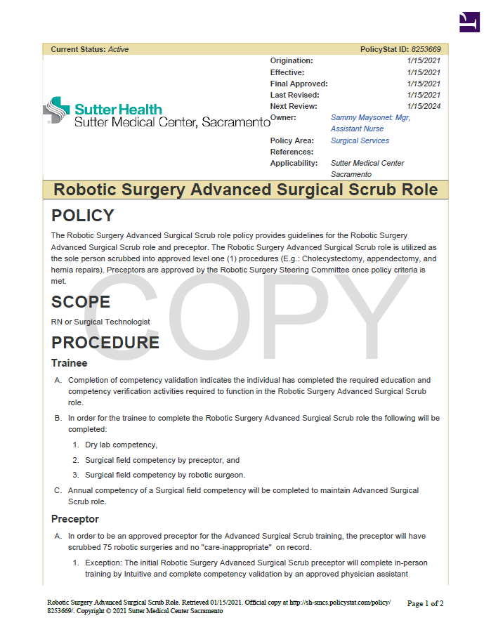
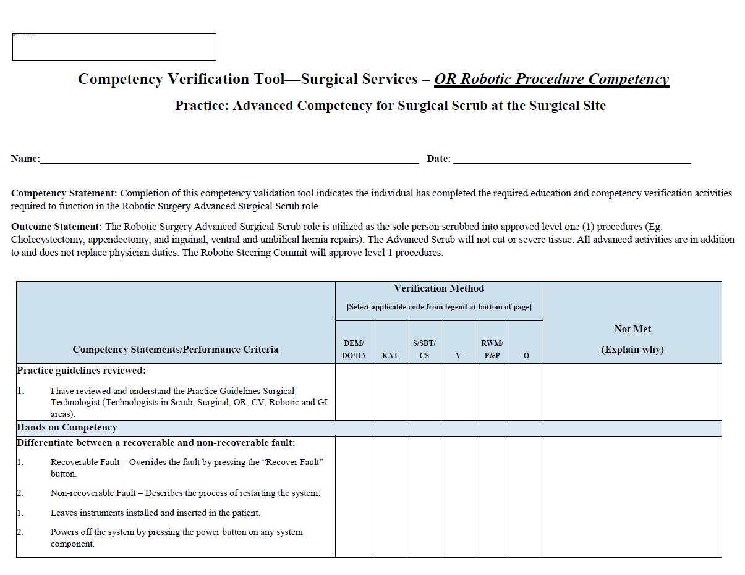
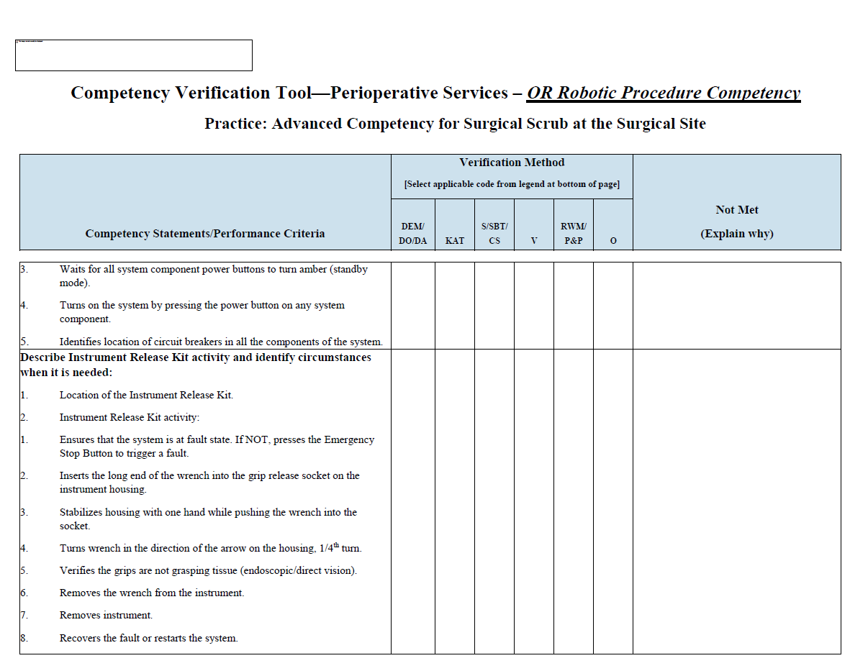
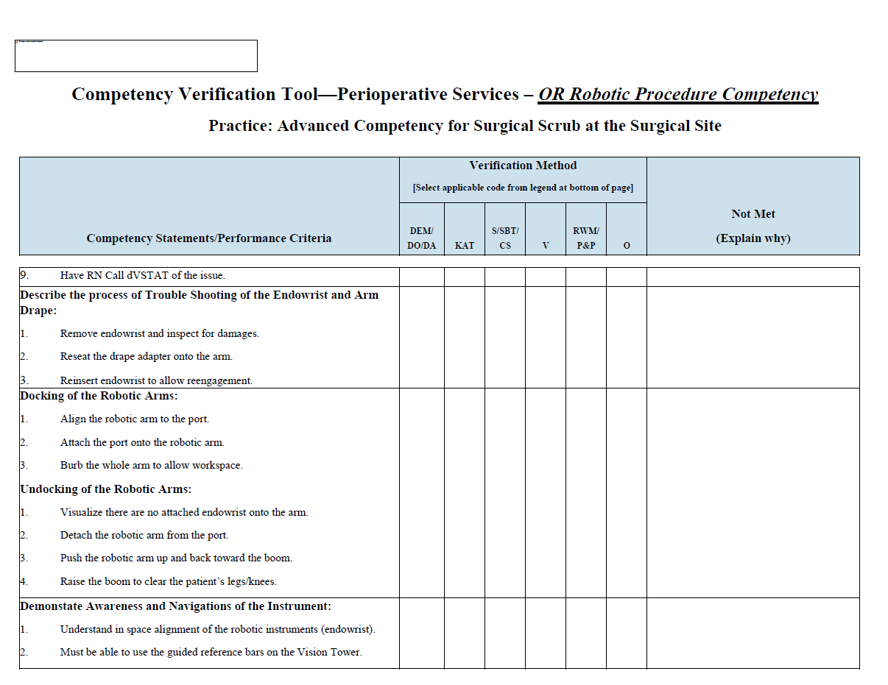
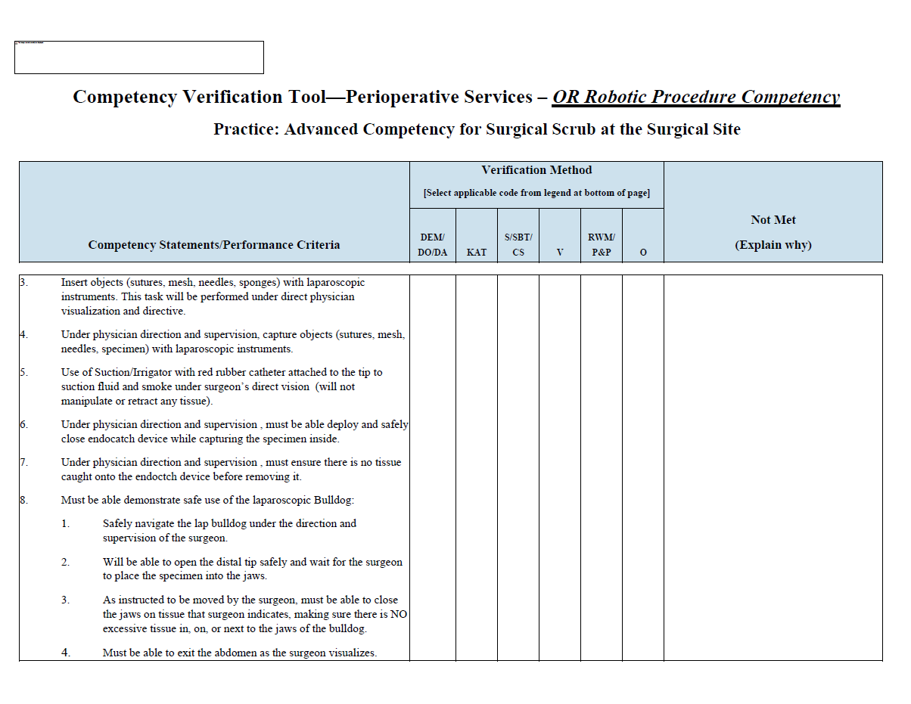
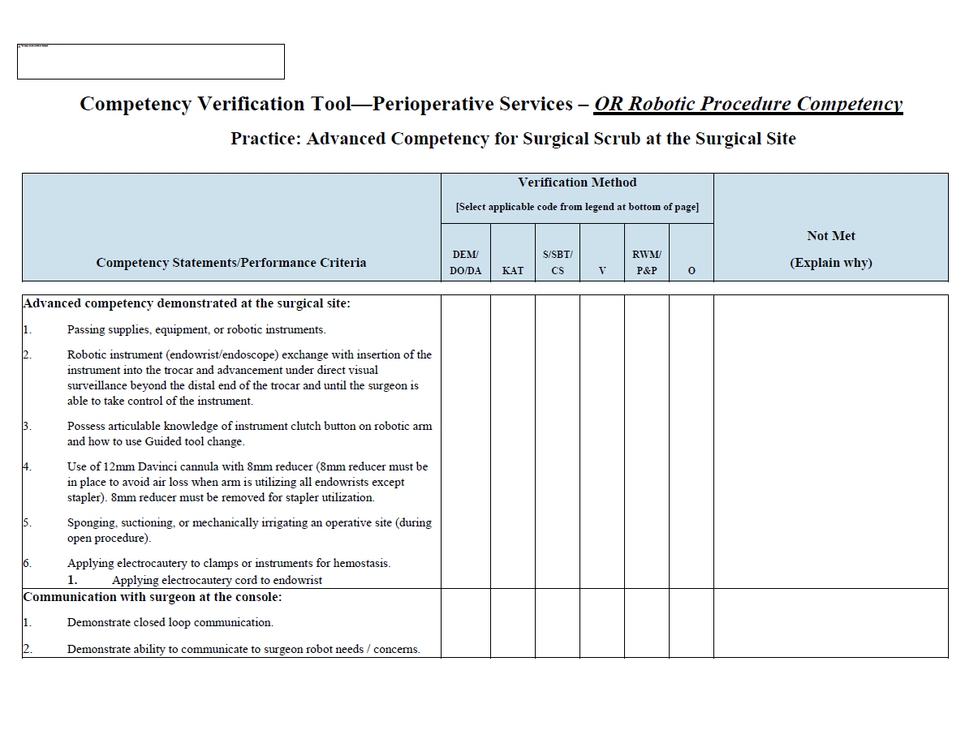
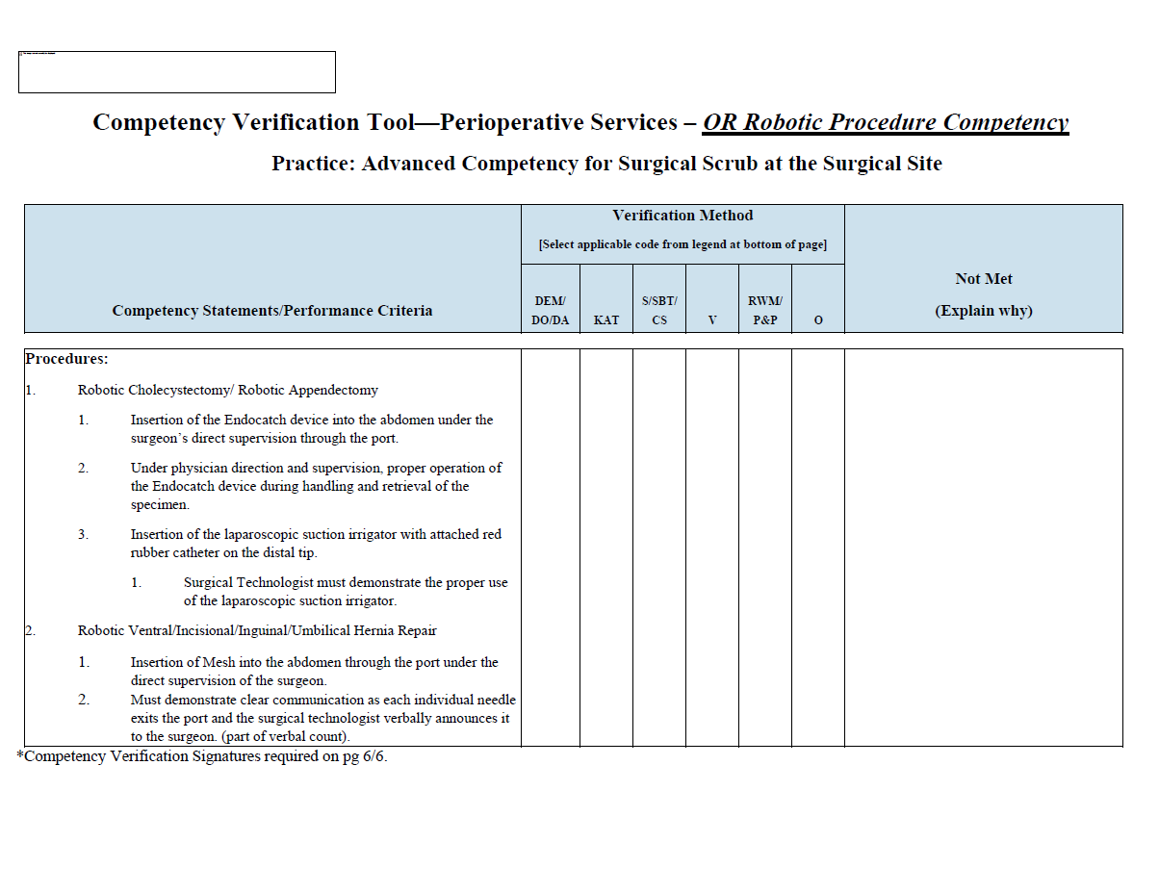
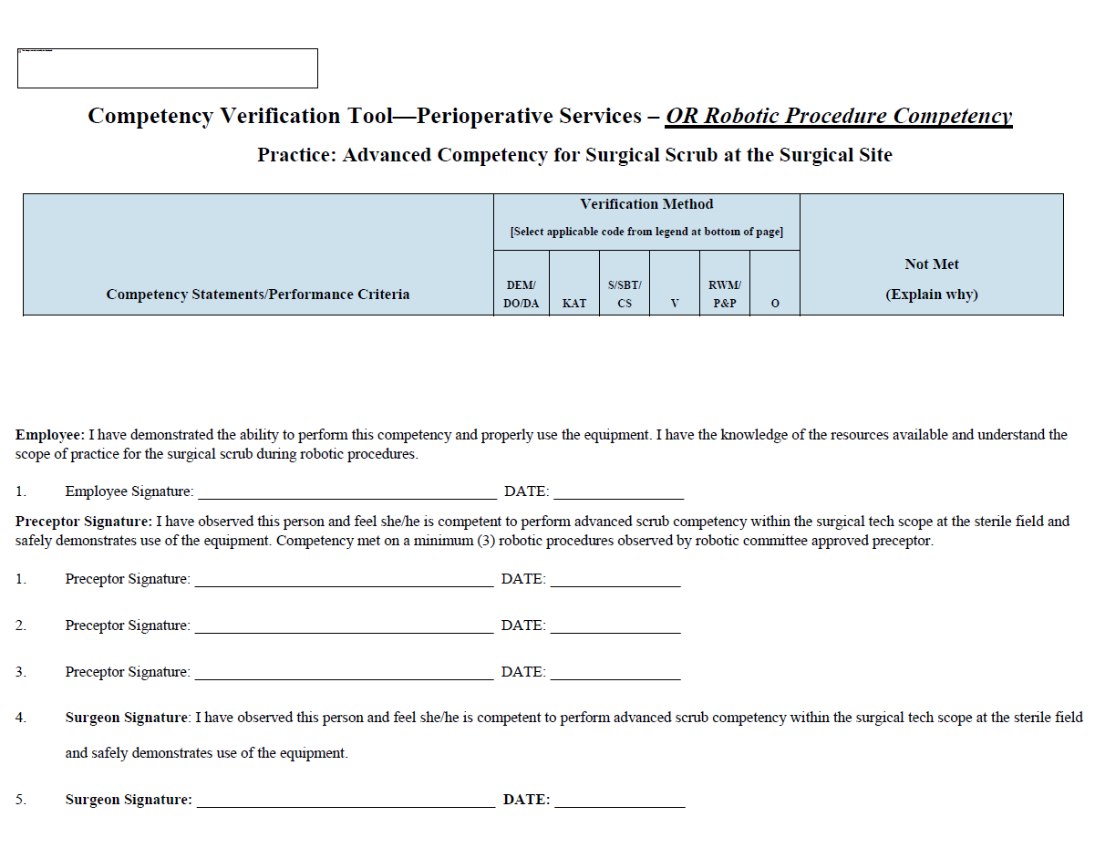
Robotic Surgery Advanced Surgical Scrub Role Policy

Slide 21
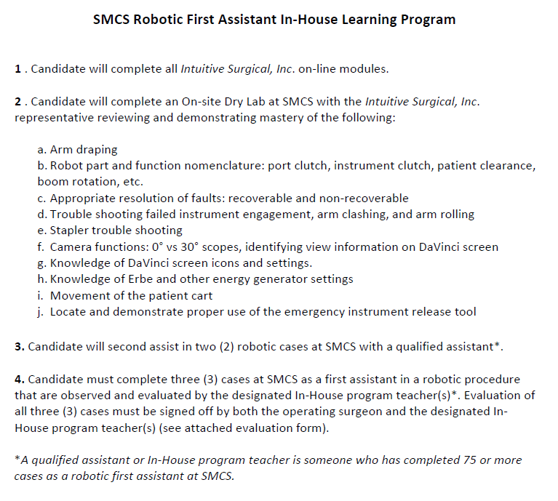

Robotic FIRST Assistant in-house learning Program

Slide 22
Pillars of Program Excellence
Clinical Excellence
Operational Excellence
Executive Leadership
Lower OR cost/case​
OR team support
Case support: FCOTS, TOT, block time
Notes:
But first…let’s spend some time discussing your role as an ESL in the process.
22

Slide 23






Operational Excellence Considerations
Monthly Robotic Steering Committee meetings (Surgeons, Admin, OR staff)
Multiple OR Teams; semi-annual competencies
“Dedicated” Robotic OR(s)
Dashboard efficiency and volume metrics
24/7 Access
Need buy-in from staff: their engagement matters

Slide 24
Start with the fundamentals: You must have a solid foundation!
ROBOTIC STEERING COMMITTEE
Notes:
.

Slide 25








Robotic Steering Committee
Charter
Formal structure
Cadence
Agenda & minutes
Dashboard
Monitor trends
Develop policy
Event oversight
Outlines goals, rules of engagement
Robert’s rules of order
Monthly, Bimonthly, or Quarterly
Blinded outcomes (SSI, ED Visits, Readmissions, etc…) and unblinded costs (surgeon and procedure-specific)
E.g., robotic downtime policy; endowrist return procedure; scrub tech assistant policy; robotic assistant in-house learning program
Case volumes, FCOTS, TAT, after hours use, and block utilization
CME; community outreach events; philanthropy engagements; marketing; celebrations; ProForma development; etc.
Sets items for discussion and review

Slide 26
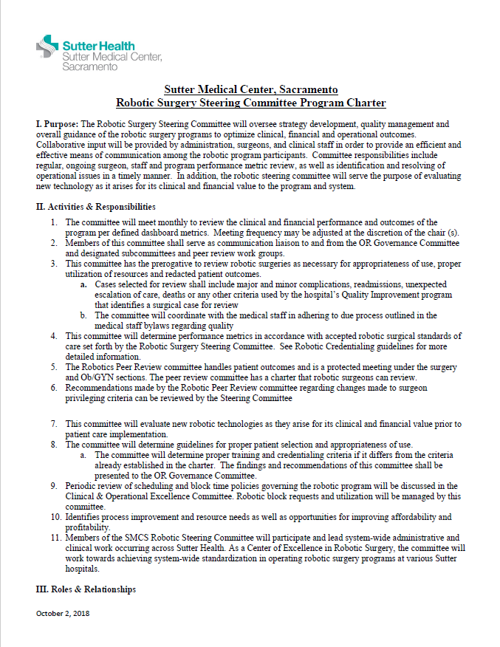
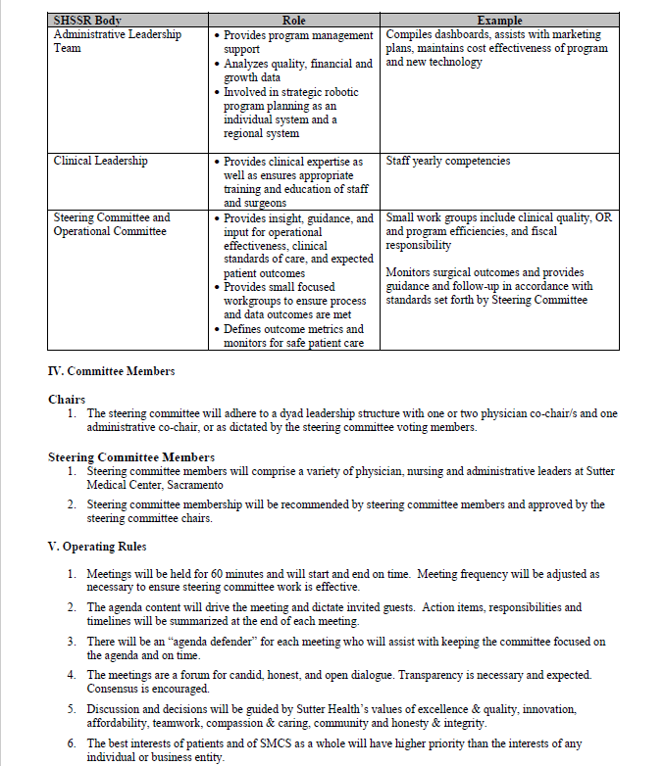

Steering Committee Charter STRUCTURE, MEMBERSHIP AND PURPOSE
Purpose
Activities & Responsibilities
Roles & Relationships
Committee Members
Operating Rules

Slide 27
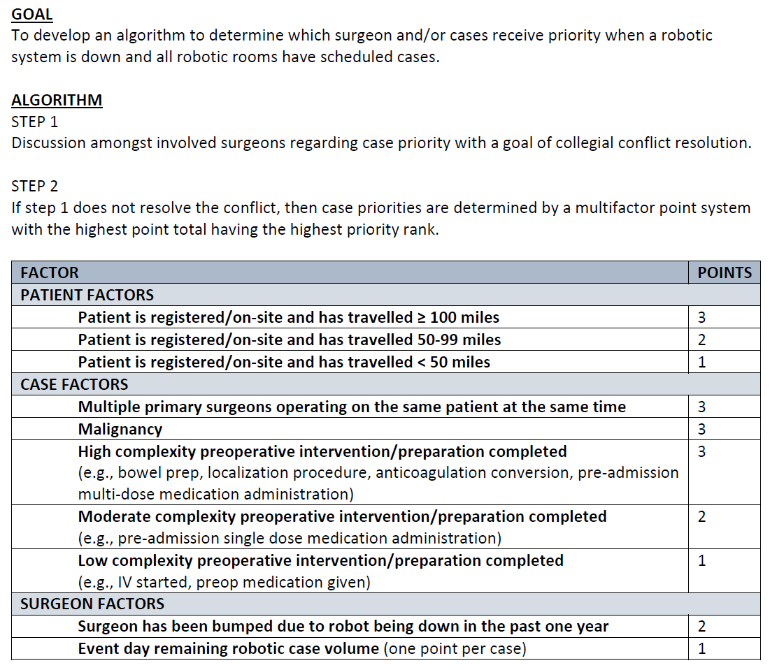
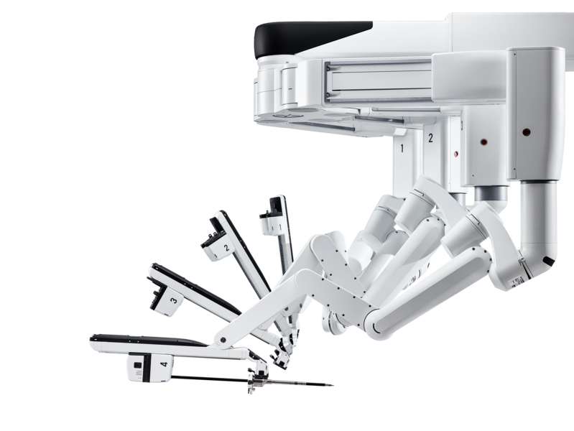
Robot Downtime Prioritization Guideline

Slide 28
Robotic block time and utilization
Past
Present
Future
Dedicated robotic rooms
Limited number of blocks
Improved scheduling efficiencies
Encourage and support after hours and weekends
Emergent case staffing mainstream

Slide 29
BLOCK TIME EXPECTATIONS
Goal = 80% block utilization
Establish clear definitions, guidelines, and expectations from the start
Robotic Steering Committee collaborates with the ORs block utilization review committee
Tracking case length times
Use of average case times for future scheduling
Managing OR availability for emergent cases and add-on’s
Block release updates: communication plan
Goal = 1/3 time is OPEN
Goal = Only full day blocks
1st quarter underutilization = notification warning / goals
2nd quarter underutilization = subject to redistribution
Data shared quarterly/monthly

Slide 30
OPERATIONAL GOALS
Identify and communicate key performance indicators
Track metrics
Share progress
Collaborate with OR team, surgeons, leadership on improvement measures
Be consistent
Performance Monitoring
Metric | Current Performance | Goal | Success
First Case On Time Starts | 75 % | 75
Wheels In to First Incision | 45 min | ---
Incisions closed to Wheels out | 15 min | ---
Wheels out to Wheels in (Turnover) | 33 min | 30
✓
×

Slide 31
Pillars of Program Excellence
Clinical Excellence
Operational Excellence
Executive Leadership
Committed to growing volume
Recruiting new surgeons
Track revenue: new, lost & retention
Notes:
31

Slide 32
Financial Snapshot - SMCS
2015 | 2019
740 | 1,411
X | 0.97X
28% | 42%
-4% | 21%
Case Volume
Direct Cost ($) per case
Contribution Margin per case
Profit Margin

Slide 33
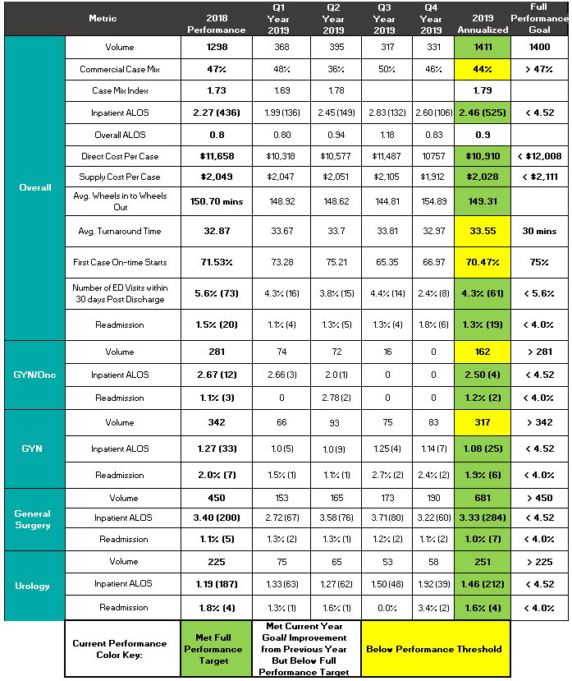
Robotic Dashboard
24 METRICS
FINANCIAL | Case Mix Index Direct Cost/case Supply Cost/case
GROWTH | Case Volume Active Service Lines
CLINICAL | ALOS 30-day ED Visit Rate 30-day Readmission Rate
OPERATIONAL | FCOTS TAT WIWO

Slide 34
The “WHAT”
DEFINE YOUR RESULT:

Slide 35

Quantify the impact
How will you know that you are successful?

Slide 36
Quantify the impact
Patient Experience Scores: Improving/Top decile
Improved outcomes
Improved provider experience
Improved patient experience
Decreased Cost
Physician Engagement Survey: Improving/Top decile
Staff Experience of Work Survey: Improving/Top decile
Direct costs: Stable/Decreasing
Contribution Margin & Profit Margin: Increasing
Clinical Outcomes: Improving
(ALOS, Readmission rates, Peer review case trends)

Slide 37
Executive surgeon leader Takeaways
Assess
your program
Do you have executive, staff, and physician participation?
Do you know what matters most to each stakeholder?
Do you have clarity of purpose?
Define your vision
Keep the “why” at the center of your program
Align around your vision
Put it in writing: Create and commit to a charter
Secure your
Executive Sponsor
Identify and align with a strategic executive sponsor
Relate the “why”: Share your vision for a robotic service line
Assemble
your program
Build the robotic steering committee foundation
Develop your dashboard
Support your vision with clinical, operational & executive excellence

Slide 38
Thank you!
Michael Beneke, MD FACS

